Slide 1
Chapter-9
REPRODUCTION
Oviparous, Viviparous, Metamorphosis,
Asexual reproduction

Slide 2
Viviparous and Oviparous Animals
Some animals give birth to young ones while some animals lay eggs which later develop into young ones.
The animals which give birth to
young ones are called viviparous animals.
Those animals which lay eggs are called oviparous animals.

Slide 4
G

Slide 5
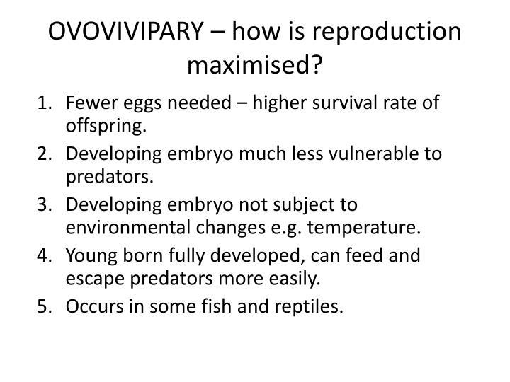

Slide 6
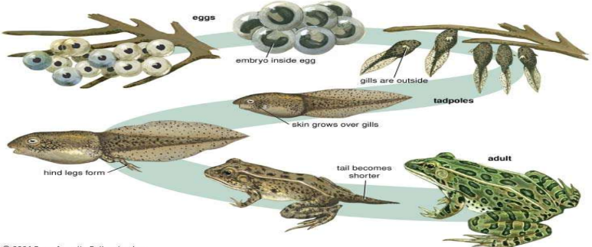
Metamorphosis is a biological process by which an
animal physically develops after birth or hatching,
involving a conspicuous and relatively abrupt
change in the animal's body structure through cell
growth and differentiation.

Slide 7
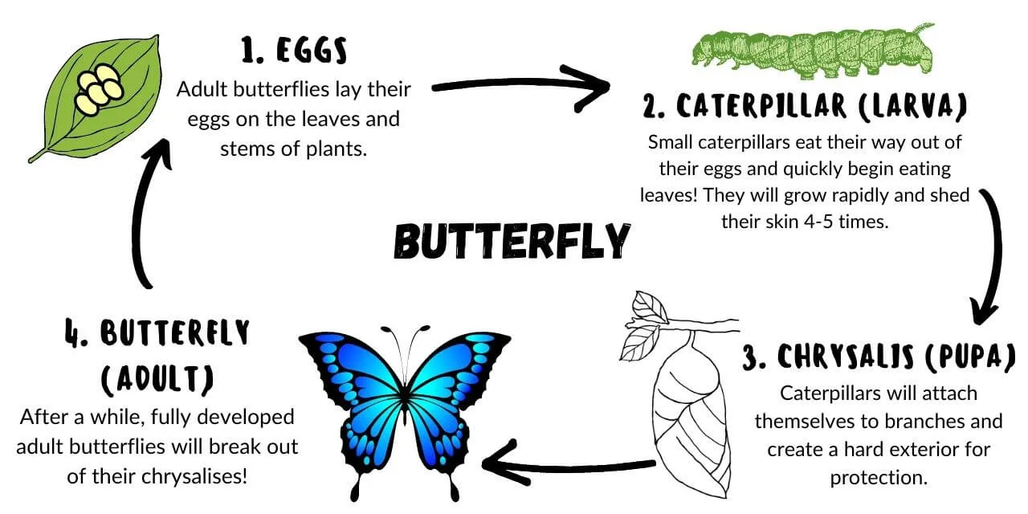

Slide 8
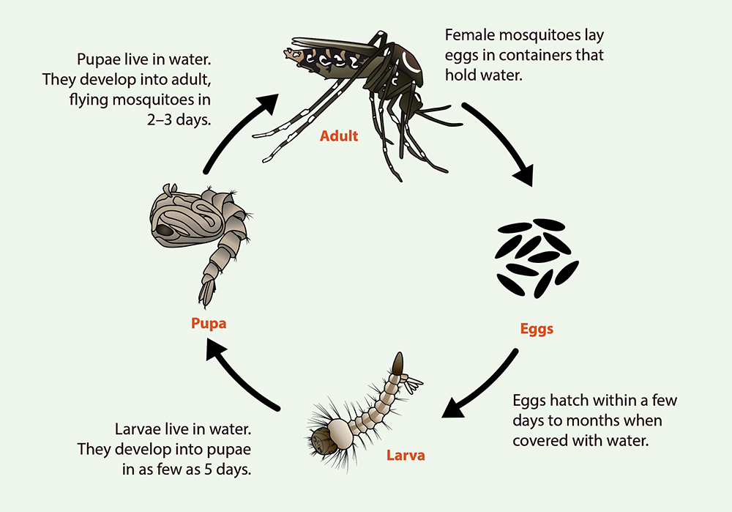
Life Cycle of a Mosquito

Slide 9
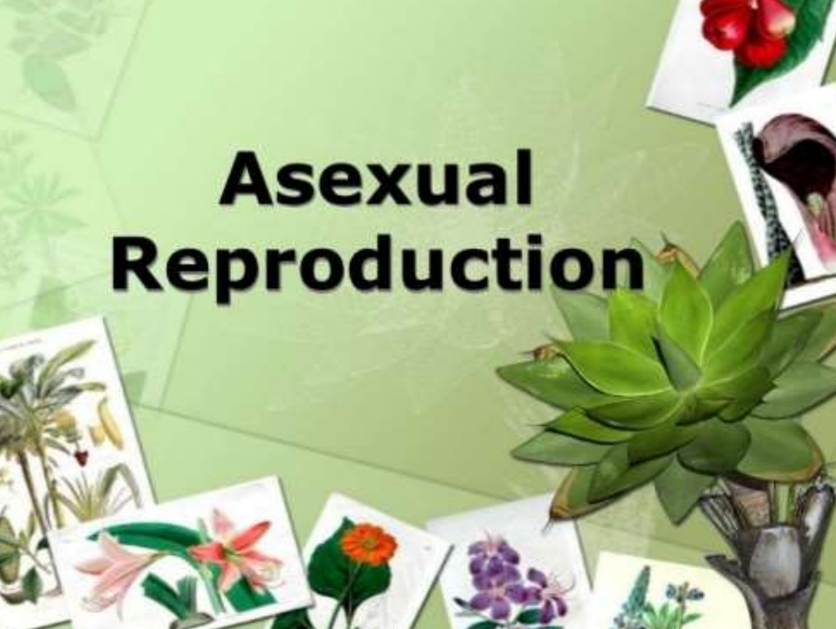

Slide 10
Asexual Reproduction
This type of reproduction in which only a single parent is involved is called asexual reproduction.
In each hydra, there may be one or more bulges. These bulges are the developing new individuals and they are called buds. In hydra too the new individuals develop as outgrowths from a single parent. Since new individuals develop from the buds in hydra, this type of asexual reproduction is called
budding.

Slide 11
Another method of asexual reproduction is observed in the microscopic organism, amoeba. Amoeba is a single-celled organisms. It begins the process of reproduction by the division of its nucleus into two nuclei. This is followed by division of its body into two, each part receiving a nucleus. Finally, two amoebae are produced from one parent amoeba. This type of asexual reproduction in which an animal reproduces by dividing into two individuals is called binary fission.

Slide 12
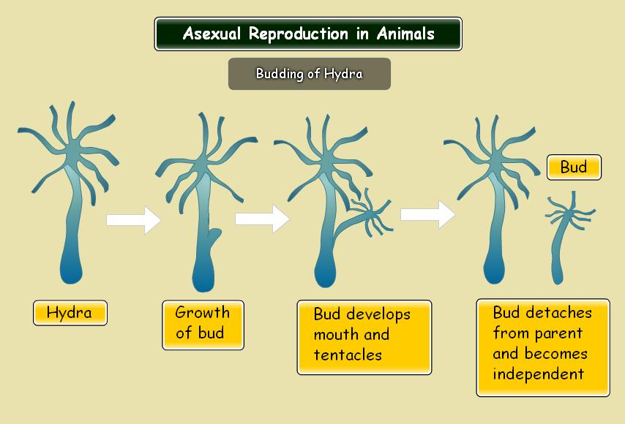
EXAMPLES OF ASEXUAL REPRODUCTION

Slide 13
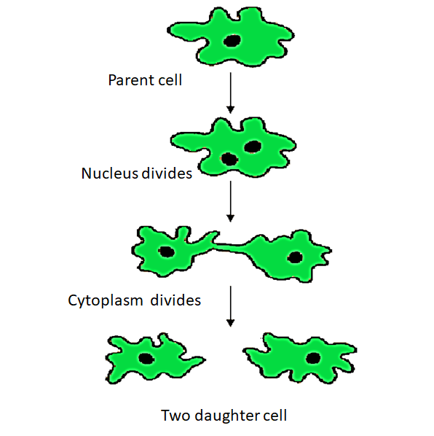
BINARY FISSION IN AMOEBA

Slide 14
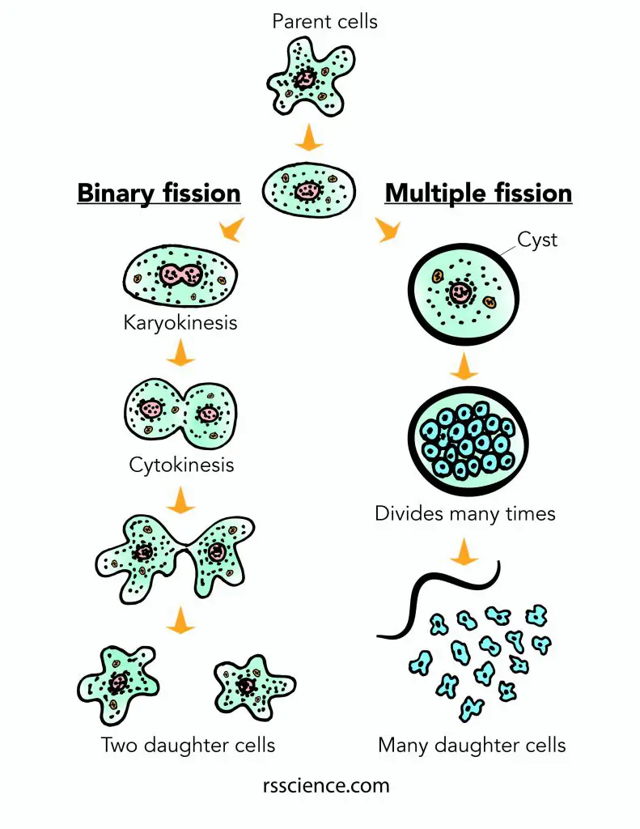

Slide 15
THANK YOU

